Slide 1
Resource Sharing in the Cloud
Characteristics: On-Demand, Pay-as-You-Go, Multi-Tenancy

Slide 2
Objectives for Today’s Class
By the end of this class, students will be able to:
Understand the concept of resource sharing in cloud computing.
Explain the key characteristics of cloud computing: on-demand, pay-as-you-go, and multi-tenancy.
Discuss the advantages and limitations of resource sharing in the cloud.

Slide 3
What is resource in the cloud?
Cloud resources are essential components provided by cloud platforms to build, deploy, and manage applications. They include:
Compute Resources: Virtual Machines (VMs), Containers, Serverless (e.g., AWS Lambda, Azure VMs).
Storage Resources: Object, Block, and File Storage (e.g., AWS S3, Azure Blob).
Networking Resources: Virtual Private Cloud (VPC), Load Balancers, DNS.
Database Resources: Relational (SQL) and NoSQL Databases (e.g., AWS RDS, DynamoDB).
Security & IAM: Access control, Encryption (e.g., AWS IAM, Azure Key Vault).
Monitoring & Logging: Performance tracking, log analysis (e.g., AWS CloudWatch).
Development Tools: CI/CD, API Gateways (e.g., AWS CodePipeline, Azure API Gateway).

Slide 4
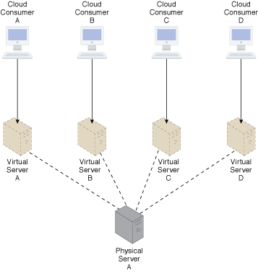
What is Resource Sharing in the Cloud?
Resource sharing in cloud computing refers to the ability to allocate and manage computing resources dynamically among multiple users, ensuring optimal usage.
Example: Multiple users sharing the same physical server but each running their own isolated virtual machine.

Slide 5
Key Characteristics of Cloud Resource Sharing
On-Demand Self-Service: Users can provision resources automatically.
Broad Network Access: Available over the network, accessible from various devices.
Resource Pooling: Providers pool computing resources to serve multiple consumers using a multi-tenant model

Slide 6
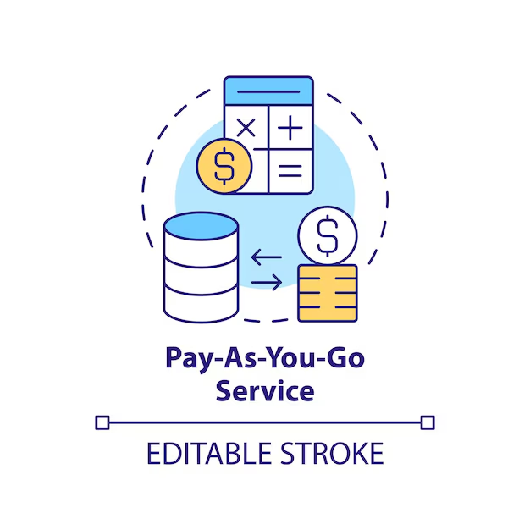
Pay-as-You-Go Model
Cloud users are charged based on their usage of resources rather than a fixed upfront cost.
Benefits:
Cost efficiency: Pay only for what you use.
Flexibility: Scale resources up or down according to need.
Example: AWS charges for storage (S3) based on the amount of data stored and transferred.

Slide 7
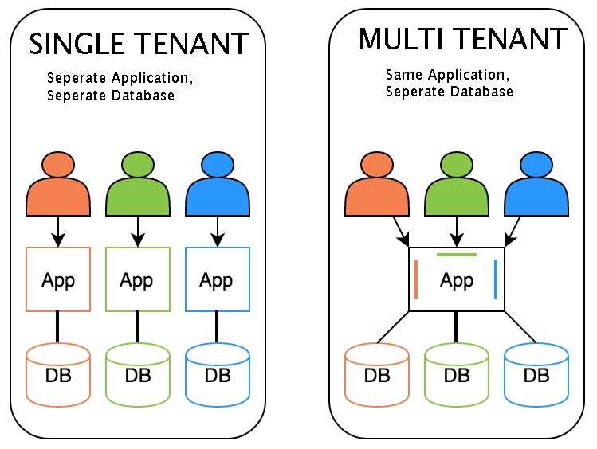
Multi-Tenancy in Cloud Computing
Multi-tenancy allows multiple customers (tenants) to share the same infrastructure while maintaining data isolation.
Key Benefits:
Efficient resource utilization.
Reduced cost per user.
Example: Salesforce provides a single instance of its CRM application to multiple companies.

Slide 8
Advantages of Resource Sharing
Cost Savings: Reduces the need for physical hardware and maintenance.
Scalability: Easily adjust resource allocation based on demand.
High Availability: Redundant (অপ্রয়োজনীয়) resources ensure system uptime and reliability.
Increased Collaboration: Teams can access shared resources and work seamlessly.

Slide 9
Challenges of Resource Sharing
Data Security Risks: Potential exposure of data in shared environments.
Performance Issues: Resource contention can occur if many users need resources simultaneously.
Compliance Issues: Ensuring regulatory compliance (e.g., GDPR) in shared environments.
Vendor Lock-in: Dependence on a single cloud provider can limit flexibility.

Slide 10
Case Study: Netflix on AWS
Scenario: Netflix uses AWS to stream content globally to millions of users.
Resource Sharing: Netflix dynamically scales its resources during peak viewing times.
Outcome: Efficient resource allocation ensures high availability and uninterrupted streaming.

Slide 11
Summary
Resource sharing in cloud computing enables efficient use of computing resources by pooling them across multiple users.
Key characteristics include on-demand self-service, pay-as-you-go, and multi-tenancy.
While it offers scalability and cost efficiency, it also poses challenges related to security and performance.

Slide 12
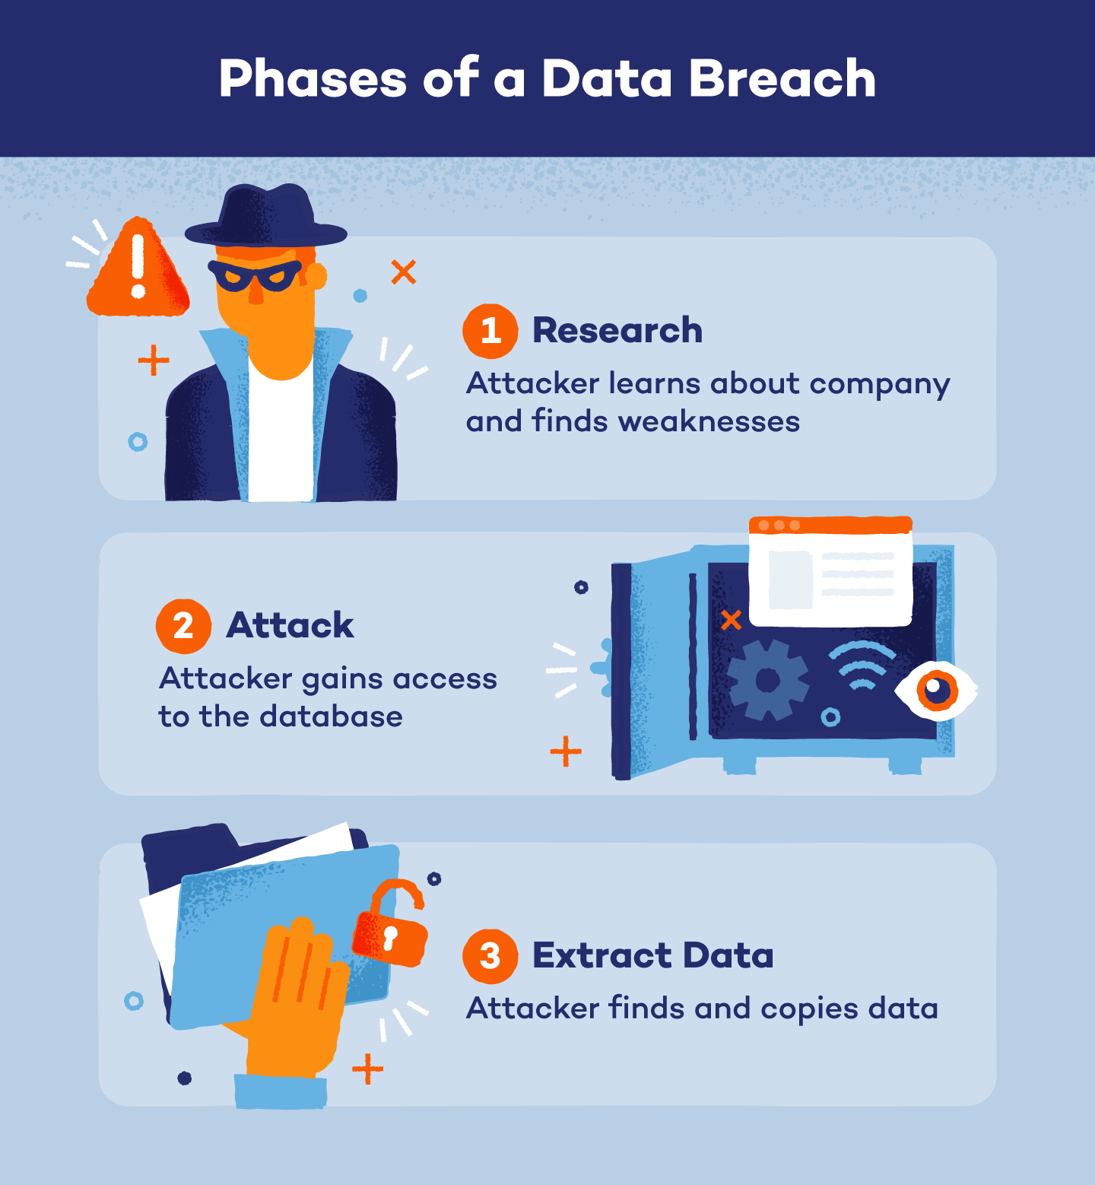
Next Class: Challenges and Risks in Cloud Computing
Discussion on data breaches, vendor lock-in, and regulatory compliance.

